Slide 1
Control Board to Fan Cable

Slide 2
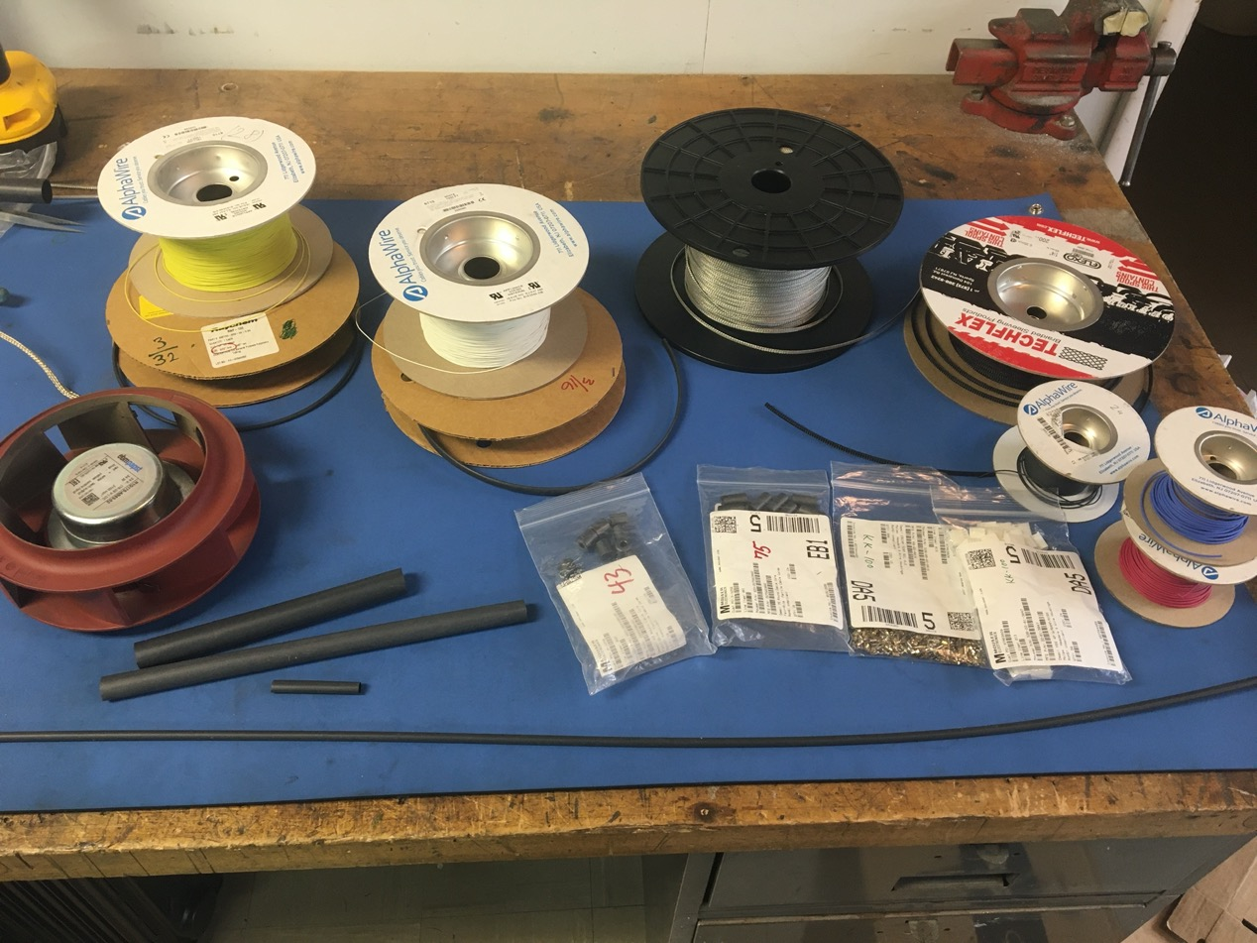
Materials

Slide 3
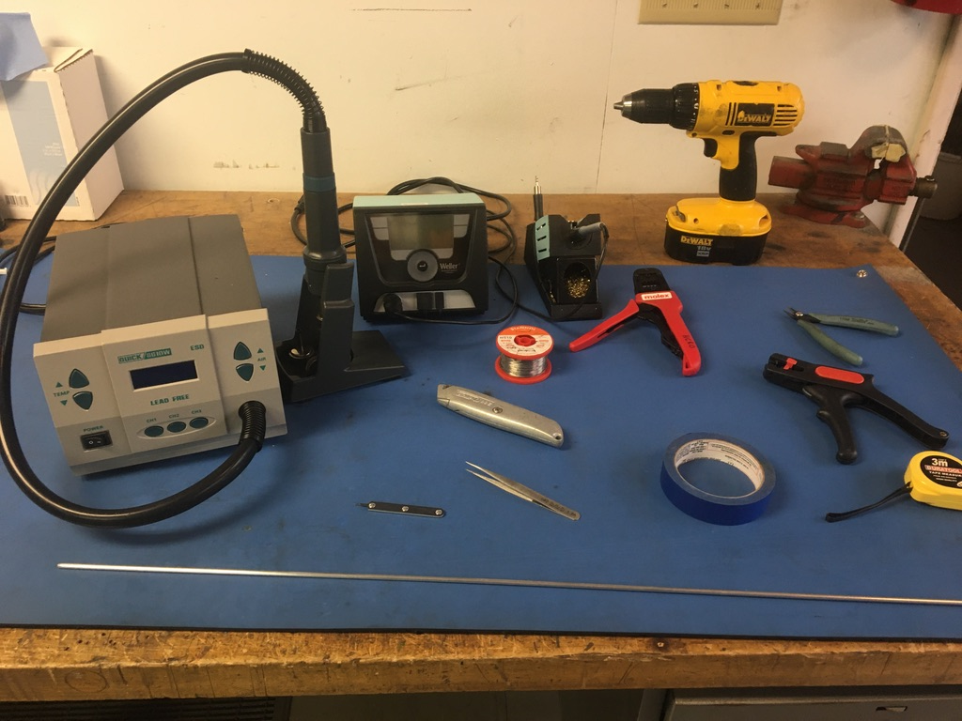
Tools

Slide 4
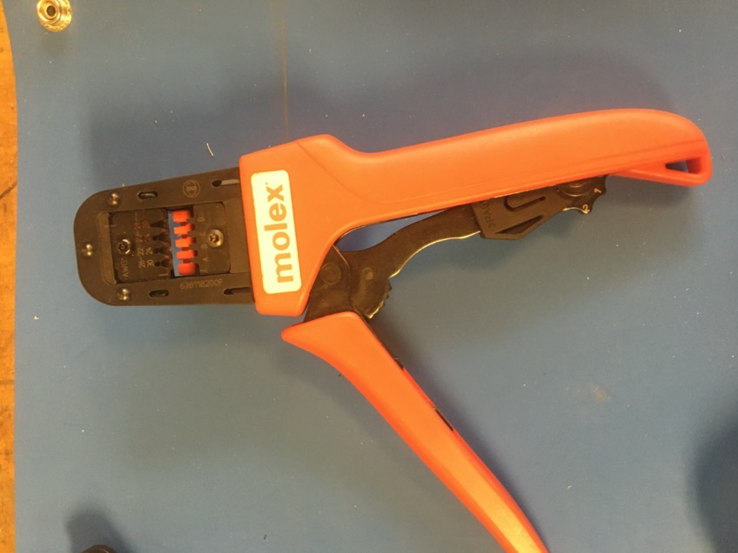
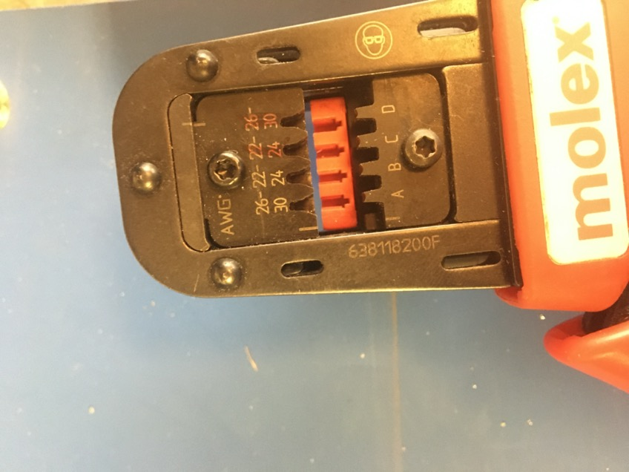
KK 254 Crimping Tool

Slide 5
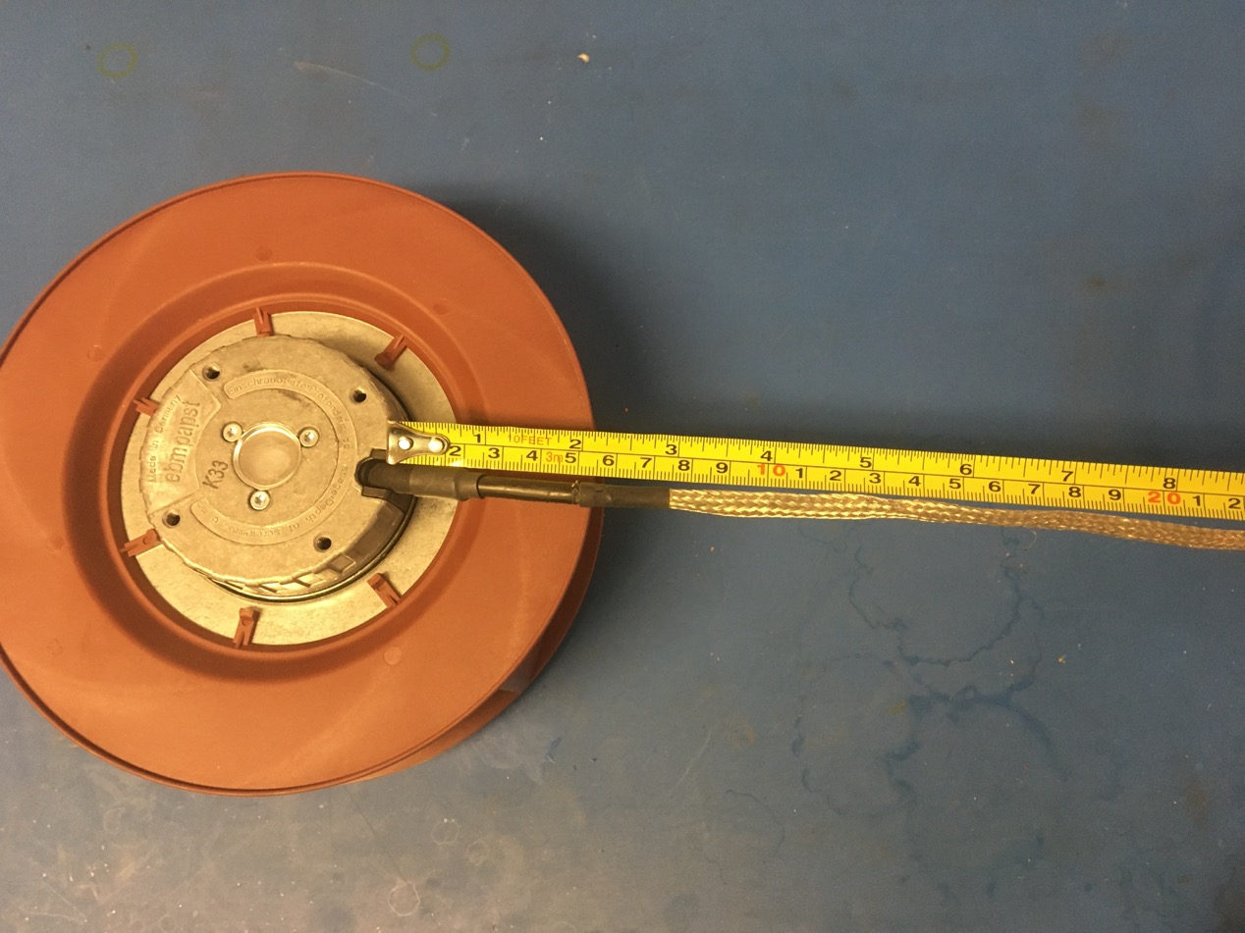
If starting with a used fan, trim the existing wire harness to 8in. If starting this process with a new fan, skip to slide 7.

Slide 6
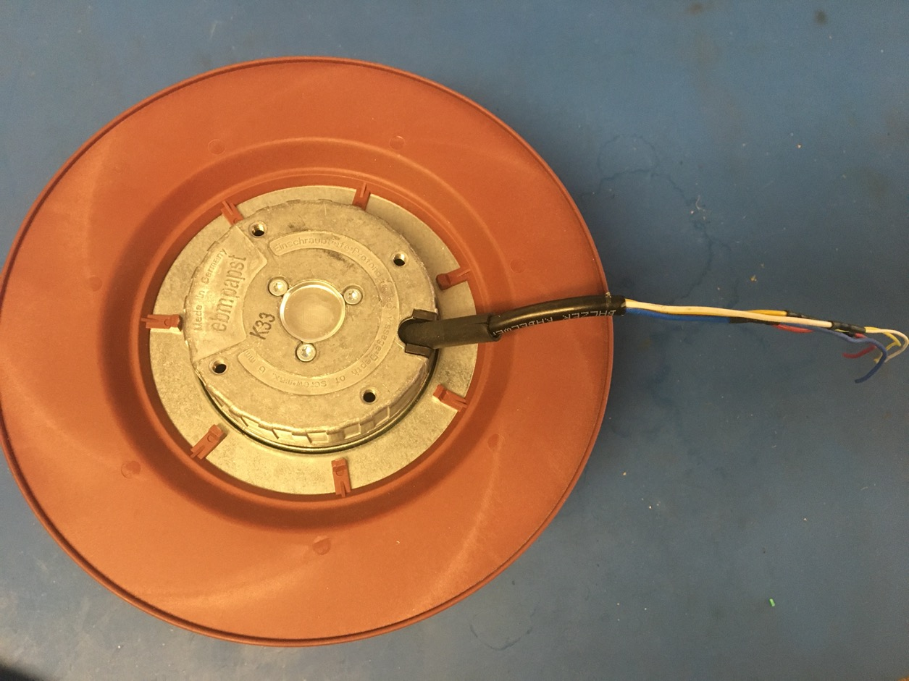
Remove the shrink tube and metal braid.

Slide 7
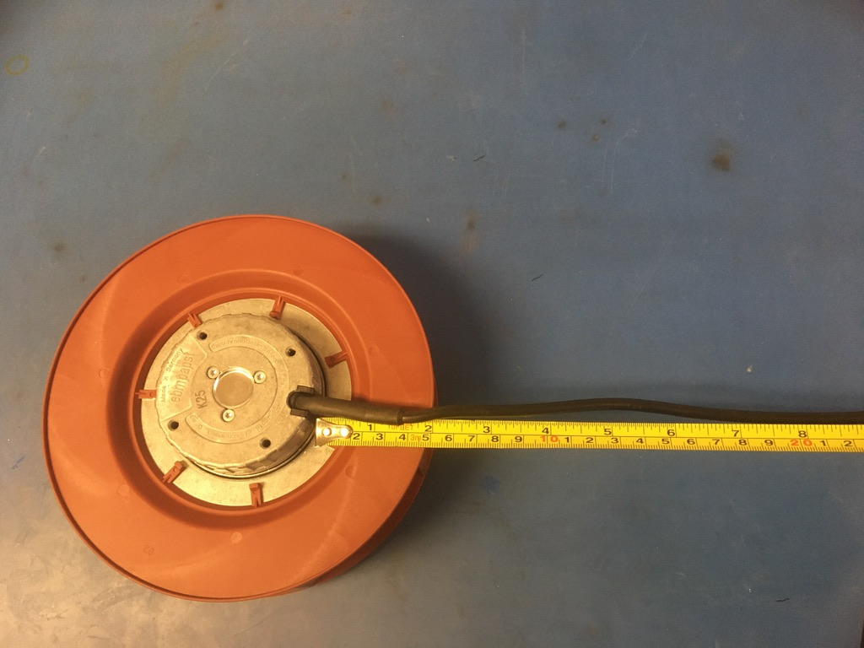
New fan
If starting this process with a new fan, trim the existing harness to be 8in long. Remove the the black isolation up until the shrink tube. Be careful not to damage the fan’s wires. Skip this slide if the fan is used.

Slide 8
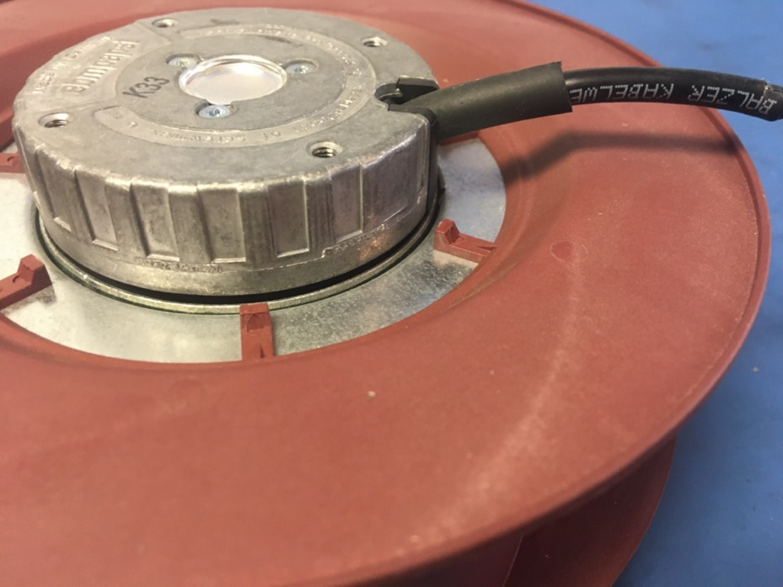
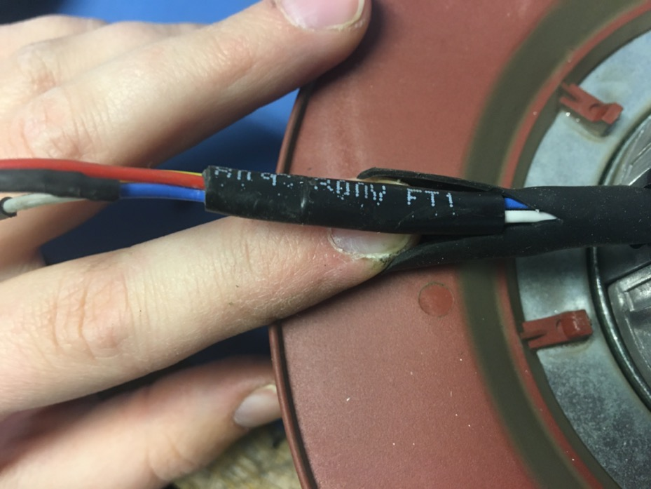
Remove the black isolation. To do this, cut into the shrink tube that’s overtop the isolation until the end of the isolation is found. Then cut the black isolation free being careful not to cut the fan’s wires.

Slide 9
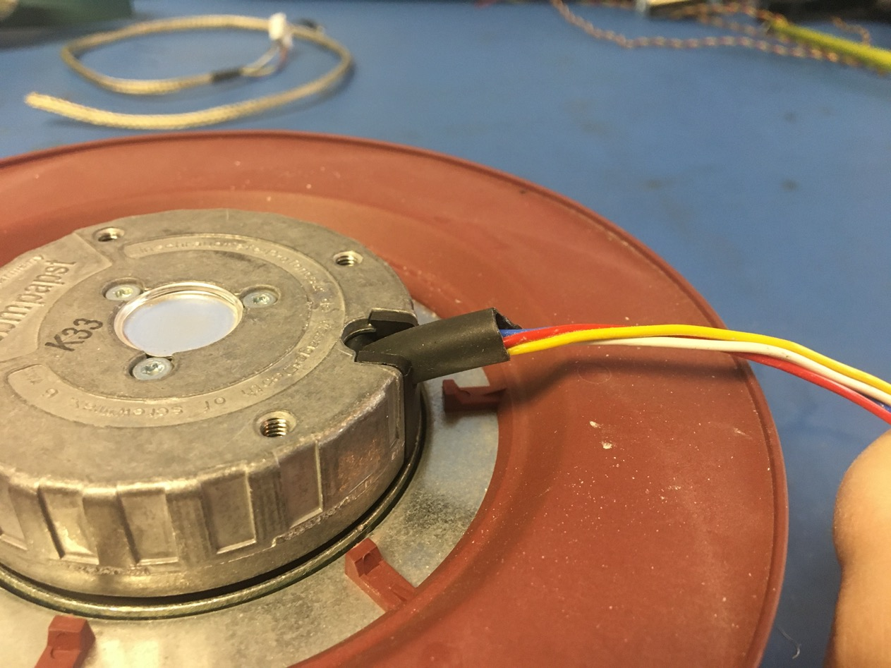
Shorten the shrink tube that was cut into until its parallel with the edge of the metal on the fan.

Slide 10
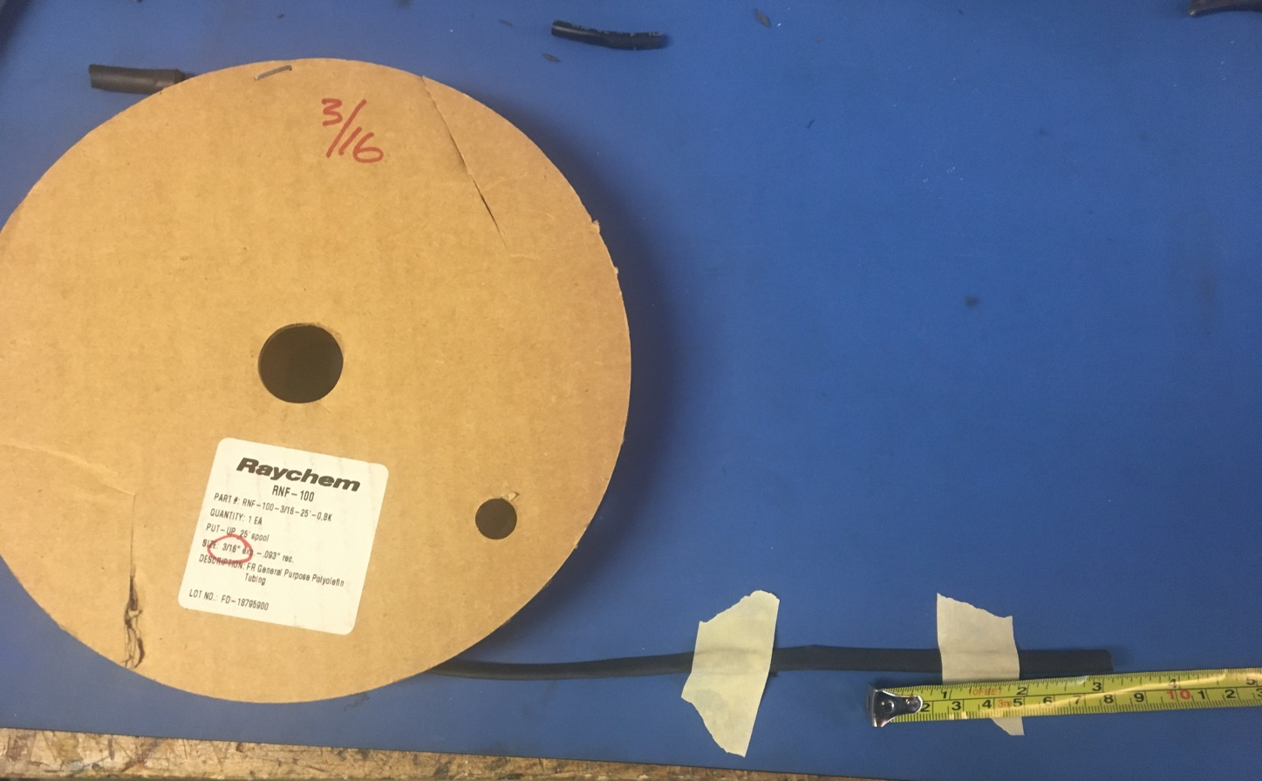
Measure out and cut one length of 3/16in non-adhesive shrink tube that’s 3in long.

Slide 11
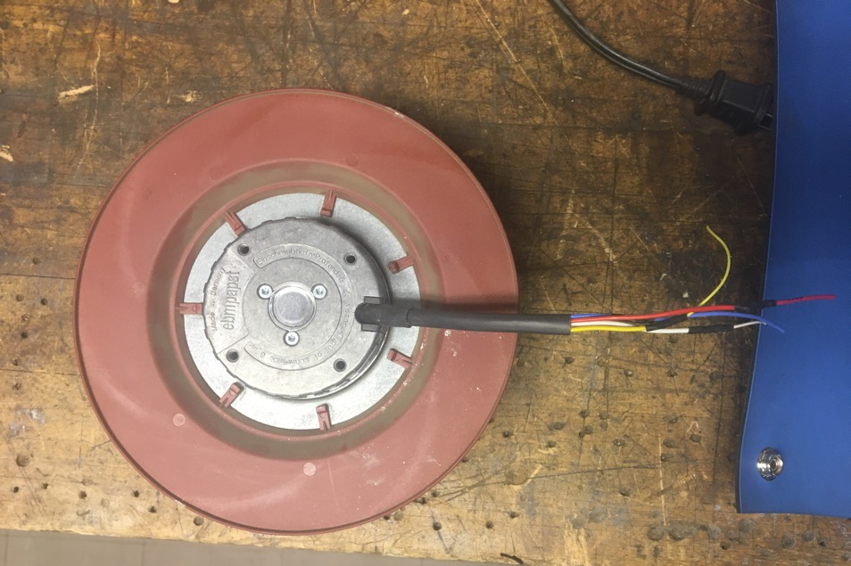
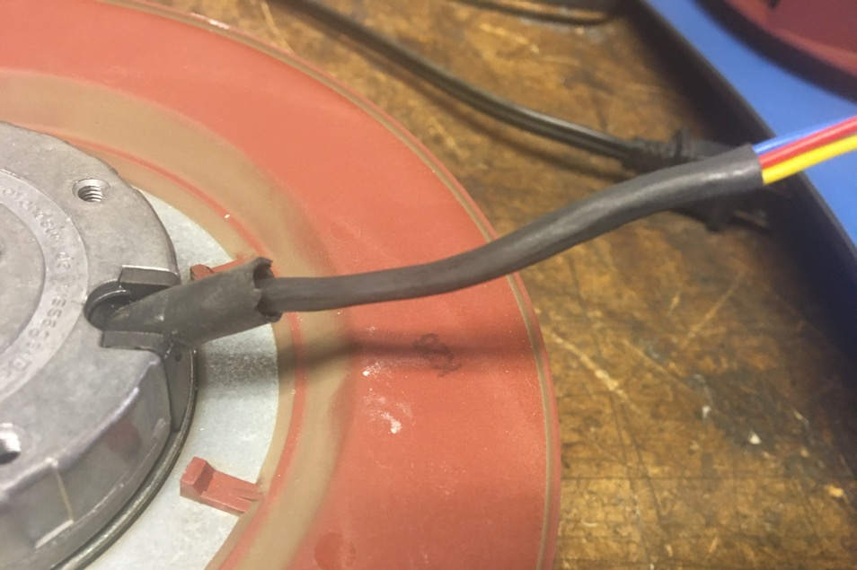
Put the piece of shrink tube onto the fan wires and slide as far as it will go toward the fan. It should even go under the existing piece of shrink tube a little ways. Apply the heat gun.

Slide 12
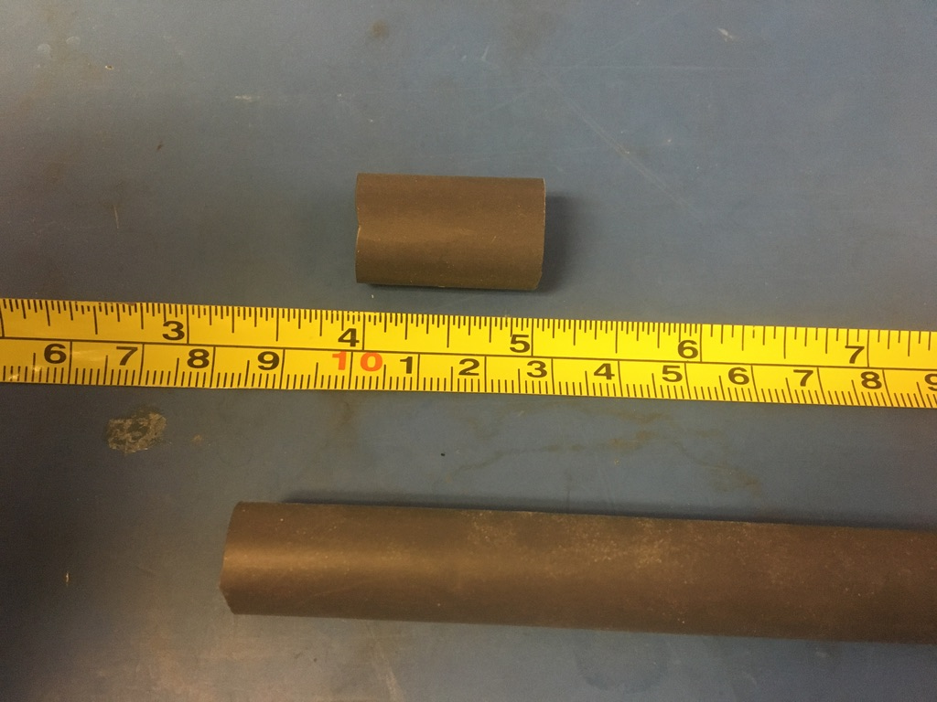
Measure out and cut one length of 12.7mm adhesive shrink tube that’s 1in long.

Slide 13
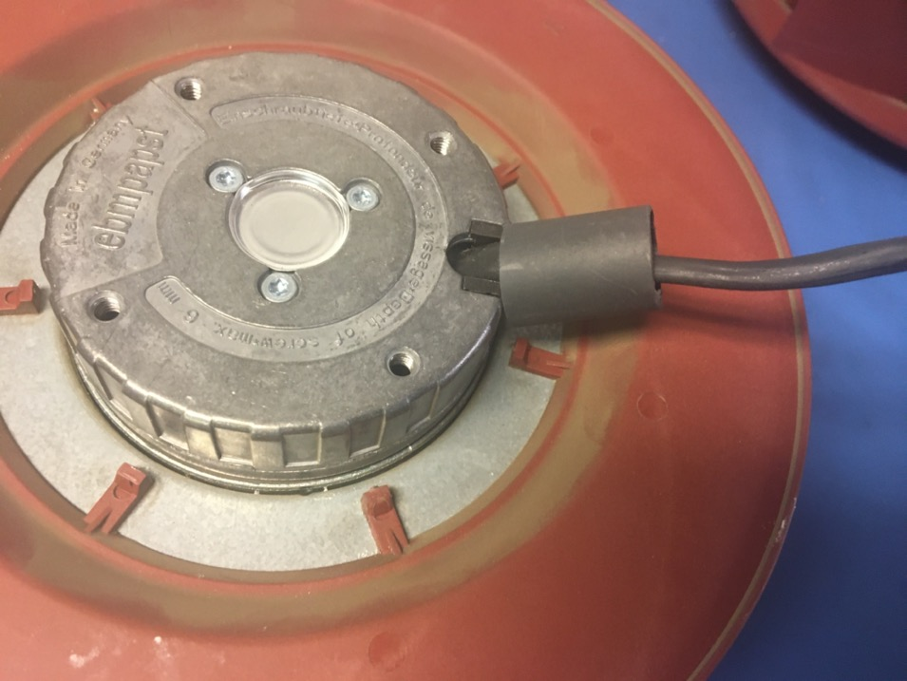
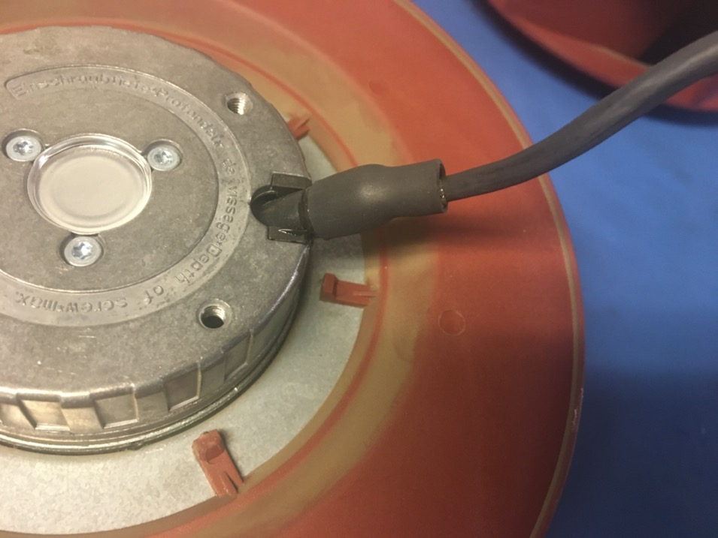
Place the piece of shrink tube over the existing shrink tube and 3/16in shrink tube joint. Apply the heat gun.

Slide 14
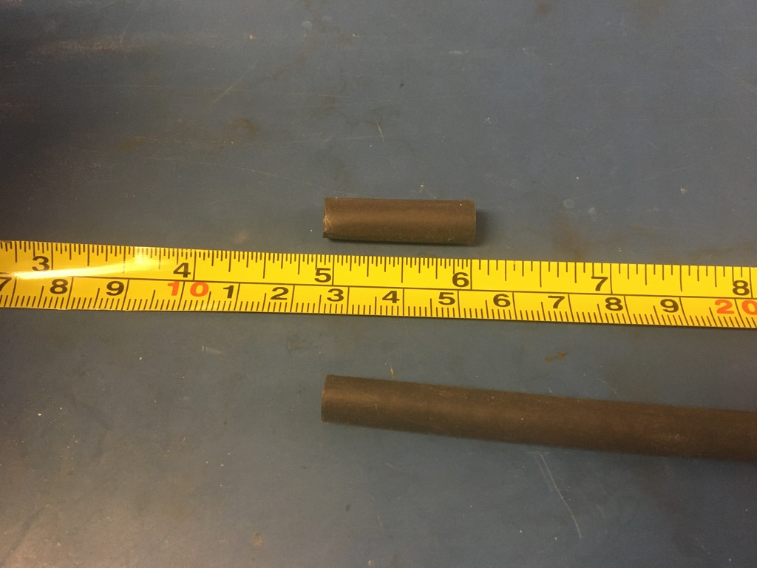
Measure out and cut one length of 6.4mm adhesive shrink tube that’s 1in long.

Slide 15
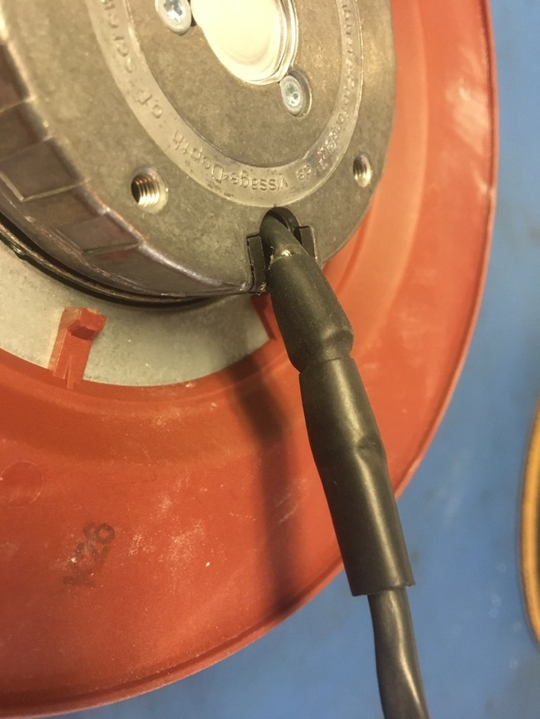
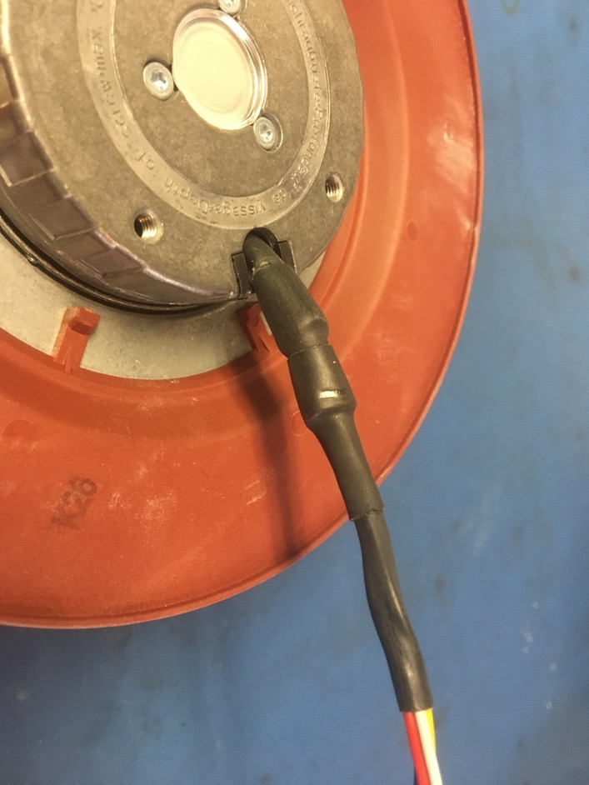
Place the piece of shrink tube over 12.7mm and 3/16in shrink tube joint. Hold the 6.4mm shrink tube in place with the tweezers while applying the heat gun (it’s prone to slide toward the 3/16in end of the joint).

Slide 16
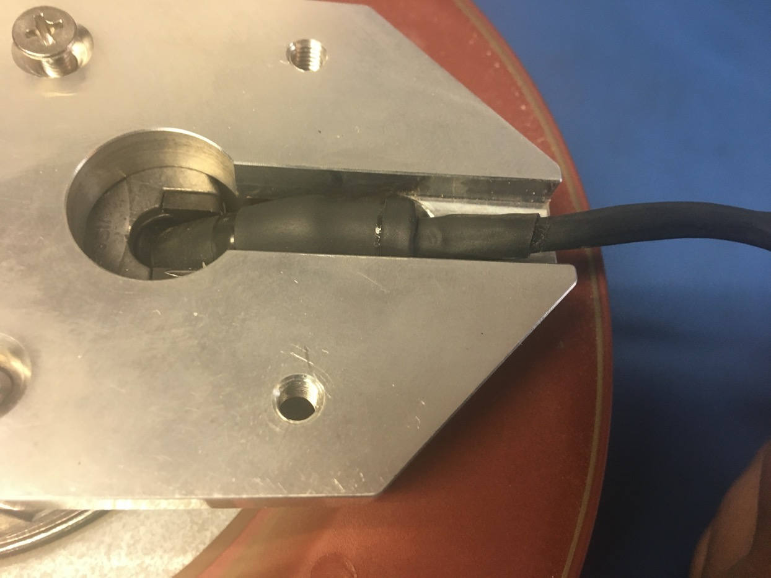
Be sure that all the shrink tube just added fits within the slot of the fan mount. If it does not, the shrink tube must be removed and replaced with smaller sizes.

Slide 17
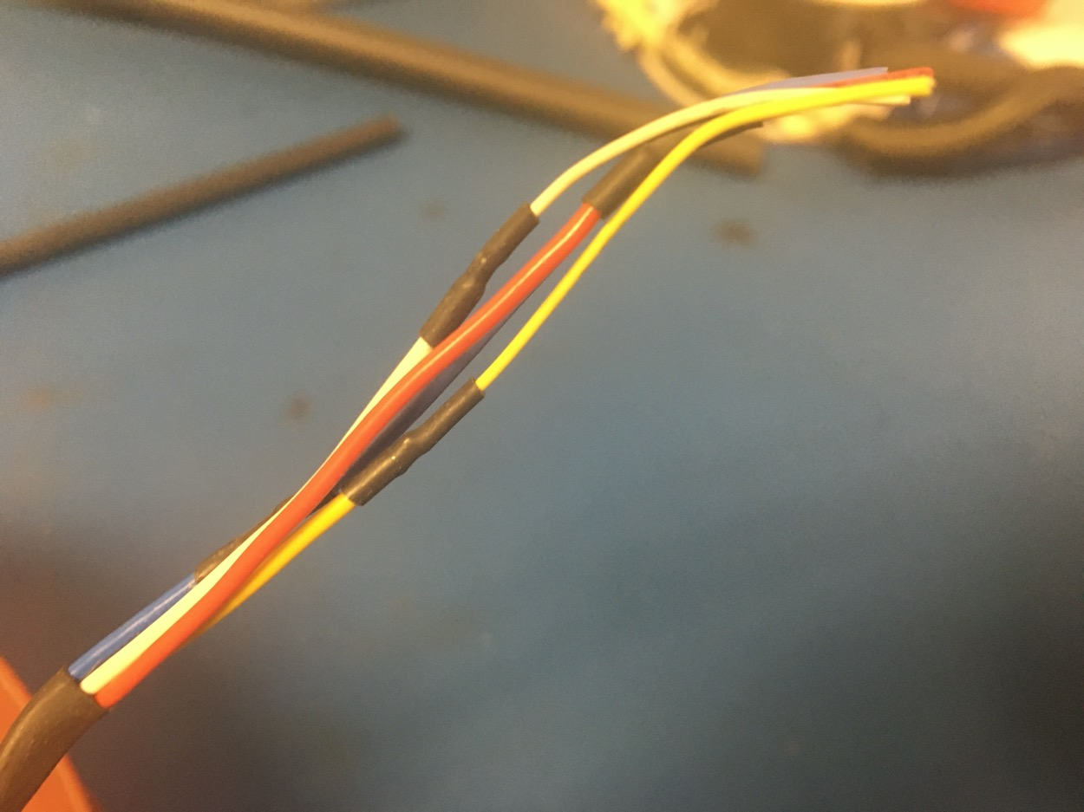
Remove the shrink tube covering the solder joints on the fan wires. If using a new fan, skip to slide 19 as the solder joints are only on used fans.

Slide 18
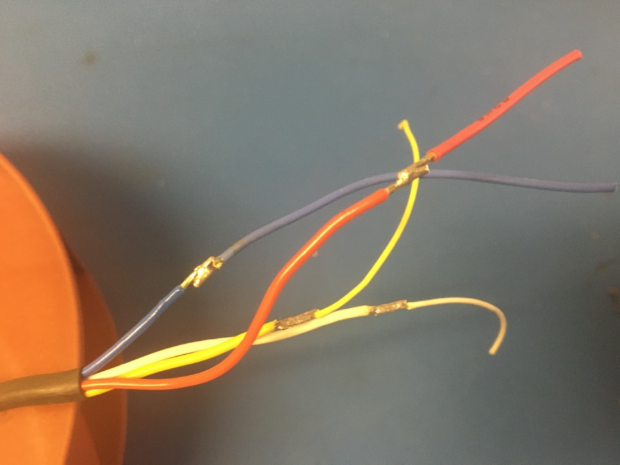
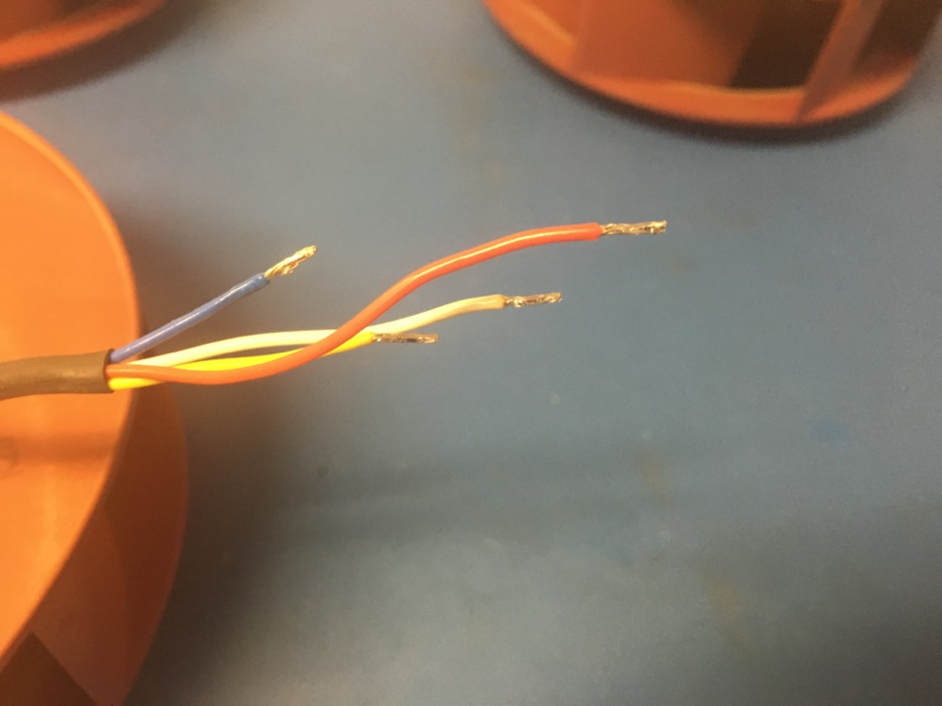
Remove (unsolder) the extensions soldered to the fan wires.

Slide 19
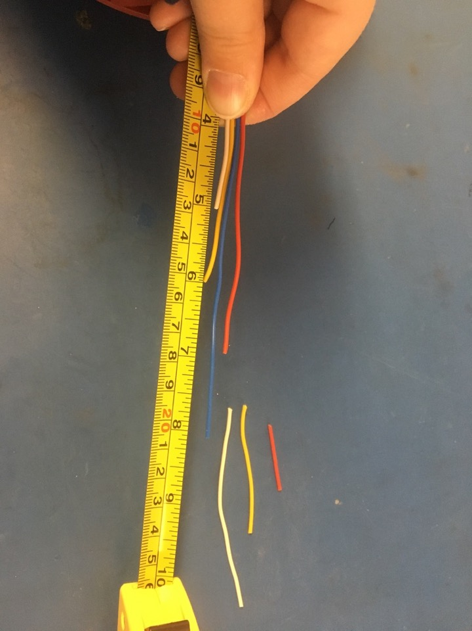
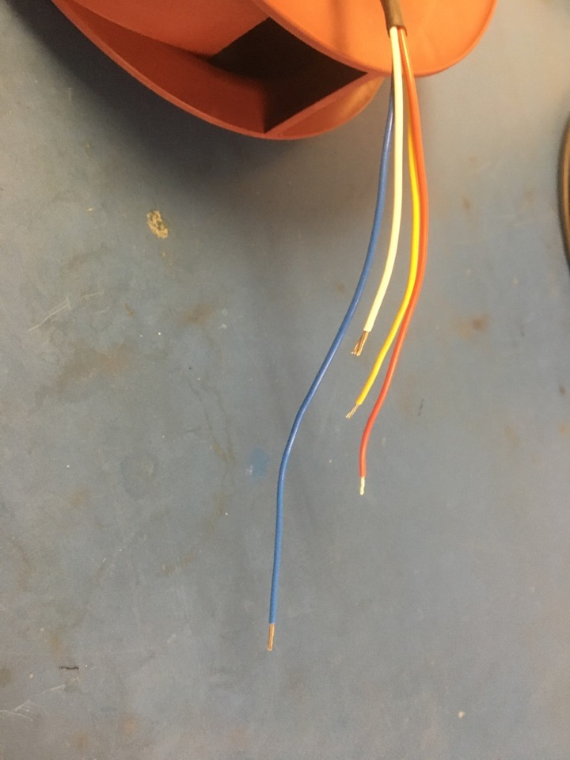
New fan
For new fans, trim the wires so that their lengths are staggered by an inch (as shown on the left). Then strip the fan wire ends. If the fan is uses, skip this slide.

Slide 20
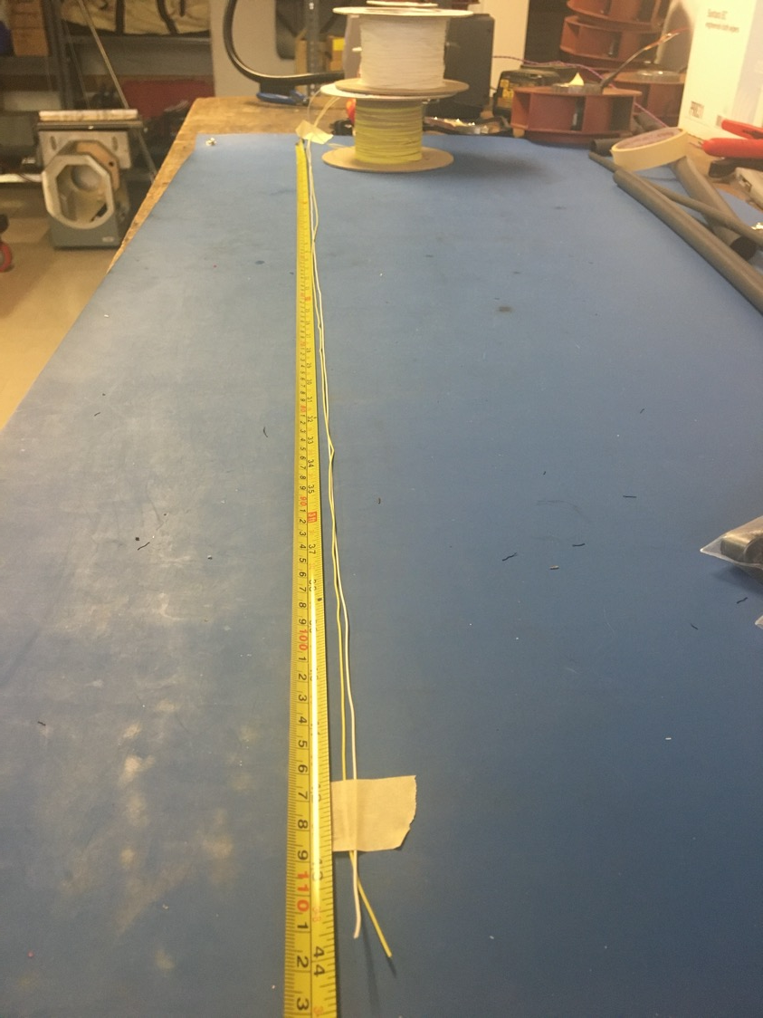
Measure out and cut 44 inches of yellow and white 28 awg as well as red and blue 20 awg wire.

Slide 21
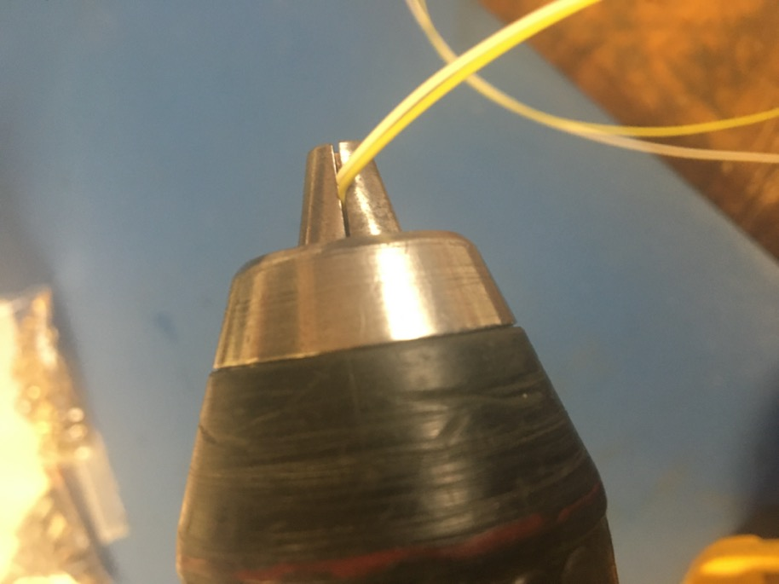
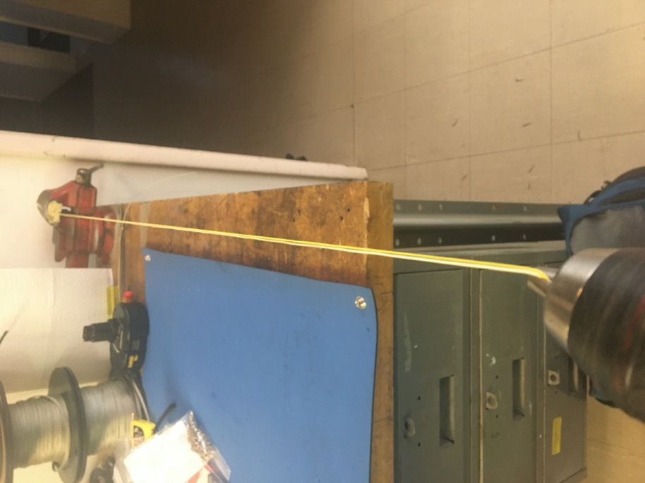
To make the twisted pair, line the vise with masking tape. Put one end of the yellow and white wires into the vise and the other into the drill. Run the drill till the wires are sufficiently twisted (for reference see the next slide). Repeat with the red and blue wires.

Slide 22
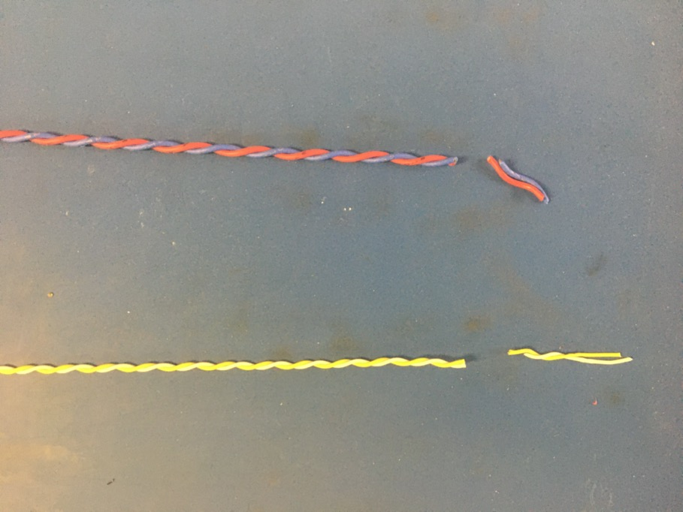
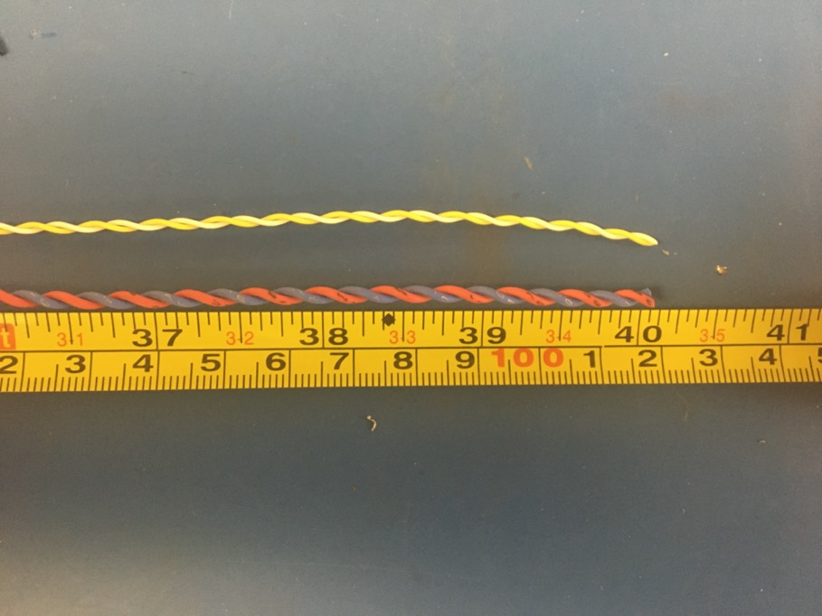
Trim the ends of each twisted pair where they were in the vise and drill. Once trimmed they should measure about 40 inches.

Slide 23
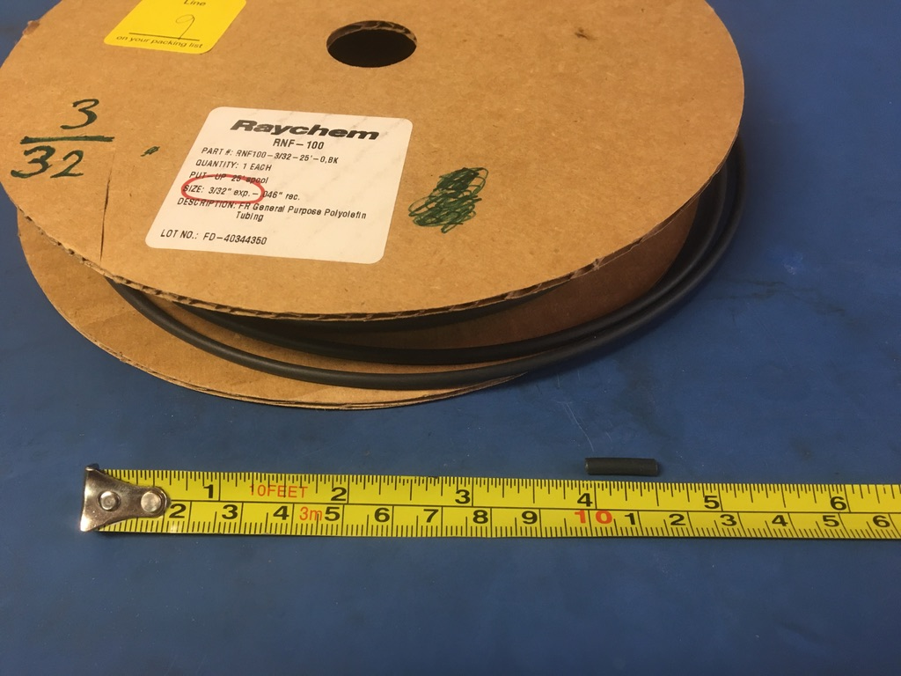
Measure out and cut four lengths of 3/32in non-adhesive shrink tube each 1in long.

Slide 24
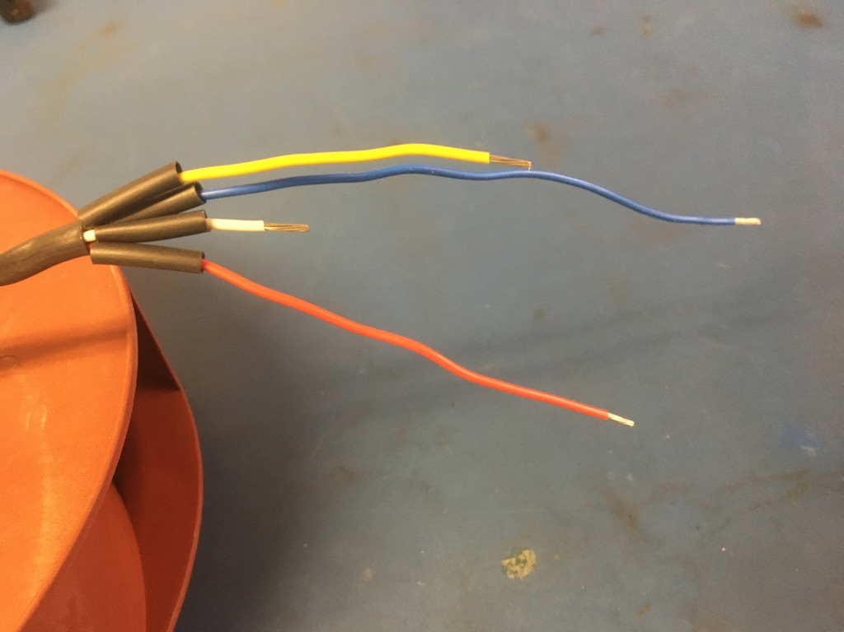
Put the pieces of shrink tube onto the fan wires.

Slide 25
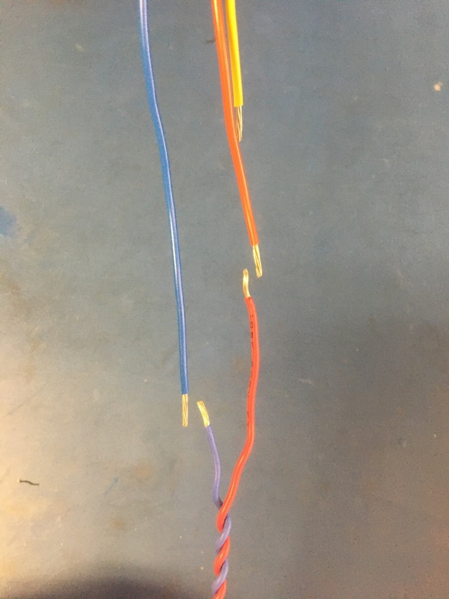
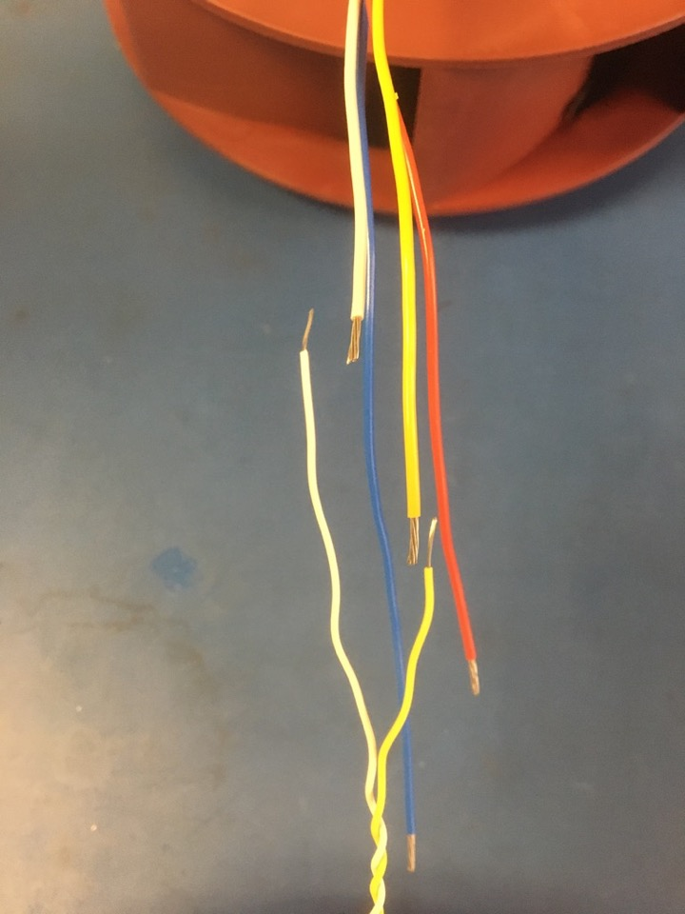
Measure and trim the twisted pairs so they match the staggered lengths of the fan wires. Strip the ends of the twisted pairs.
Stripped tips

Slide 26
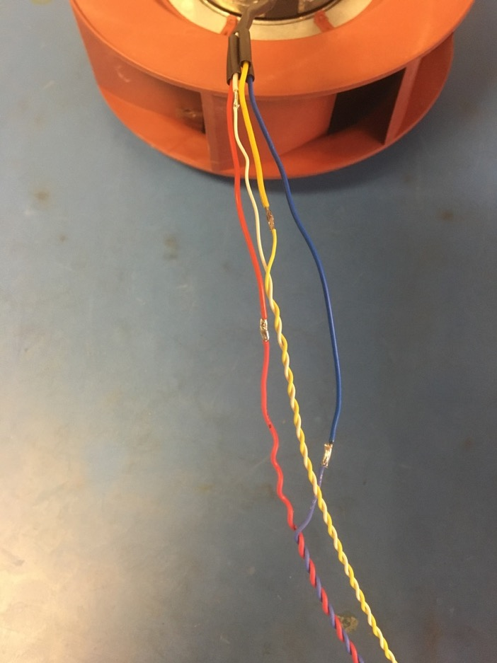
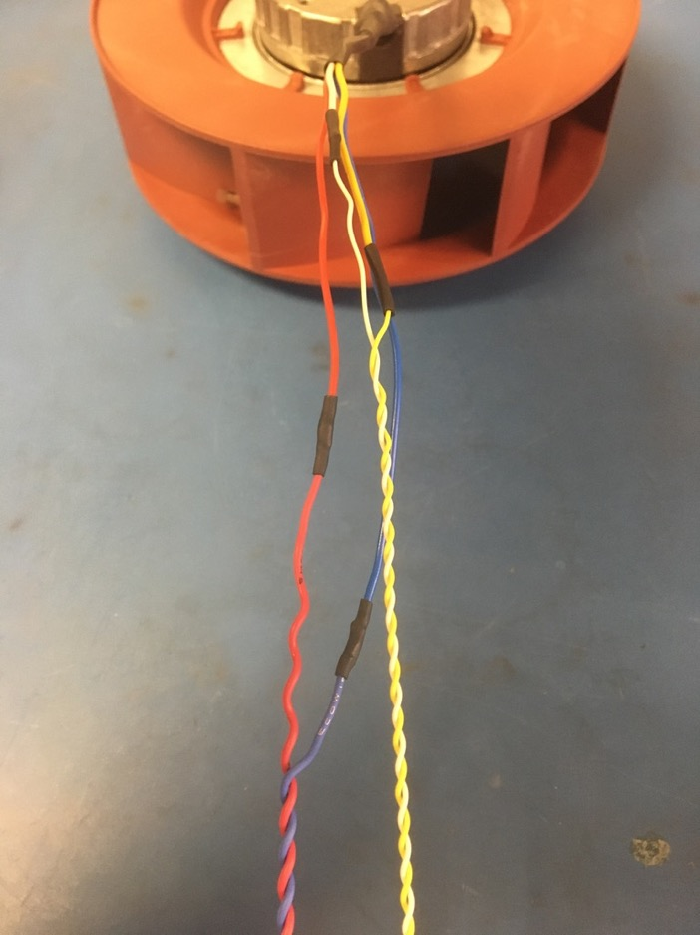
Solder the twisted pairs to the fan wires. Then slide the pieces on shrink tube down the wires and over the solder joints. Apply the heat gun.

Slide 27
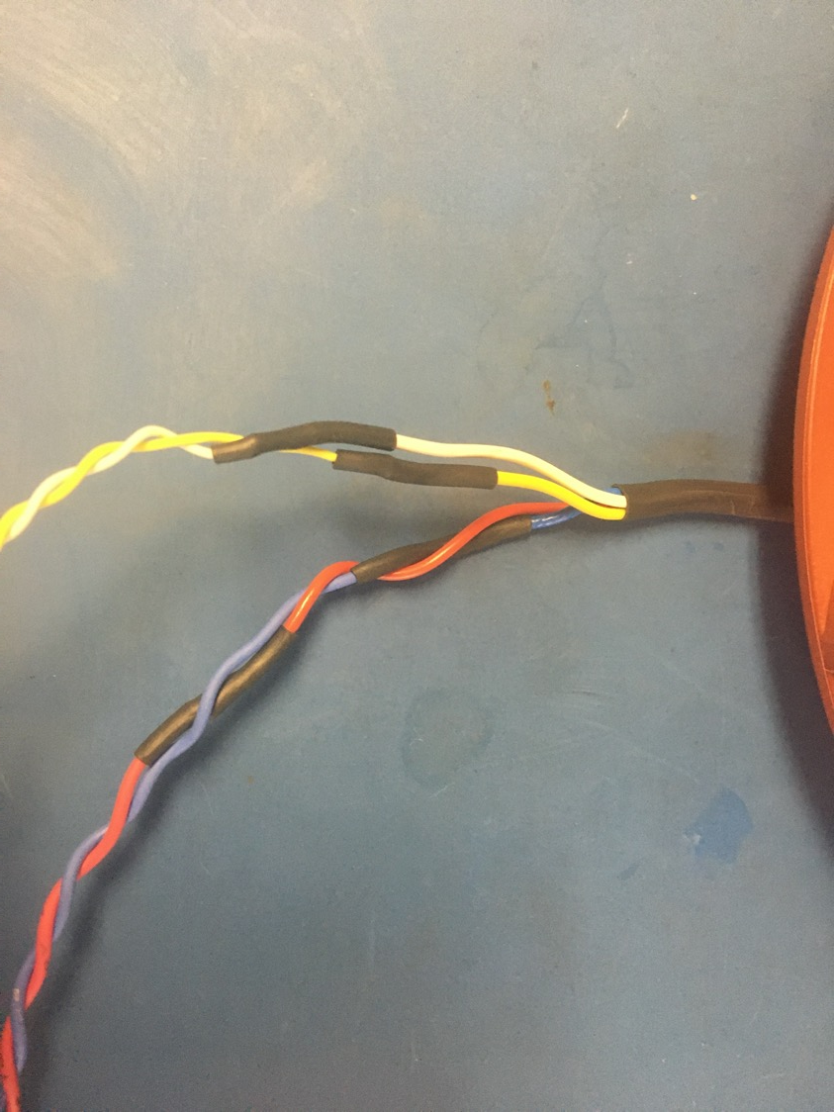
Twist the solder wire joints so they appear as shown on the left.

Slide 28
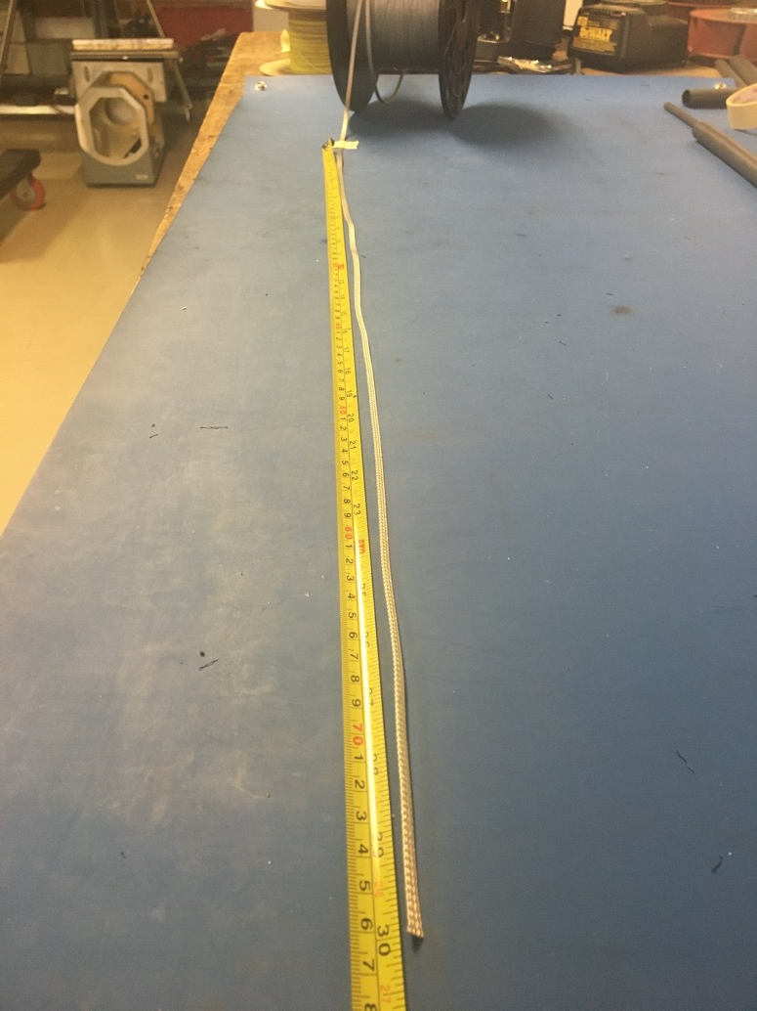
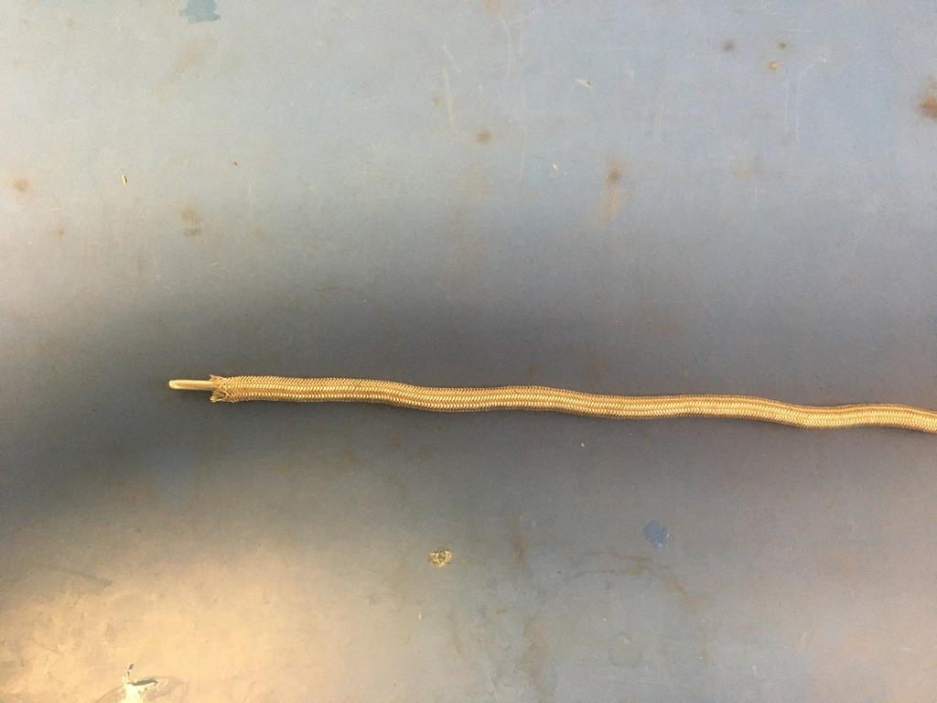
Measure out 30 inches of the 1/8th metal braid. Expand it using the metal rod.

Slide 29
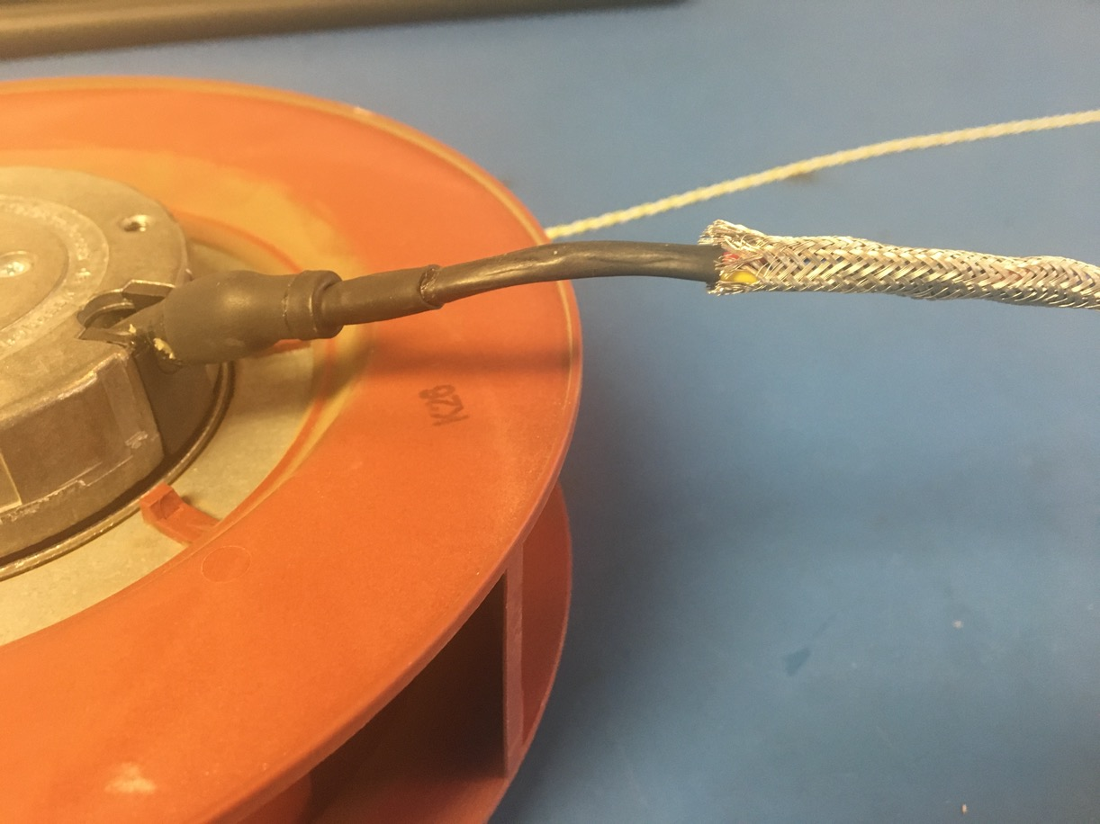
Put the expanded metal braid onto the twisted wires. Slide the metal braid all the way to the end of the shrink tube next to the fan.

Slide 30
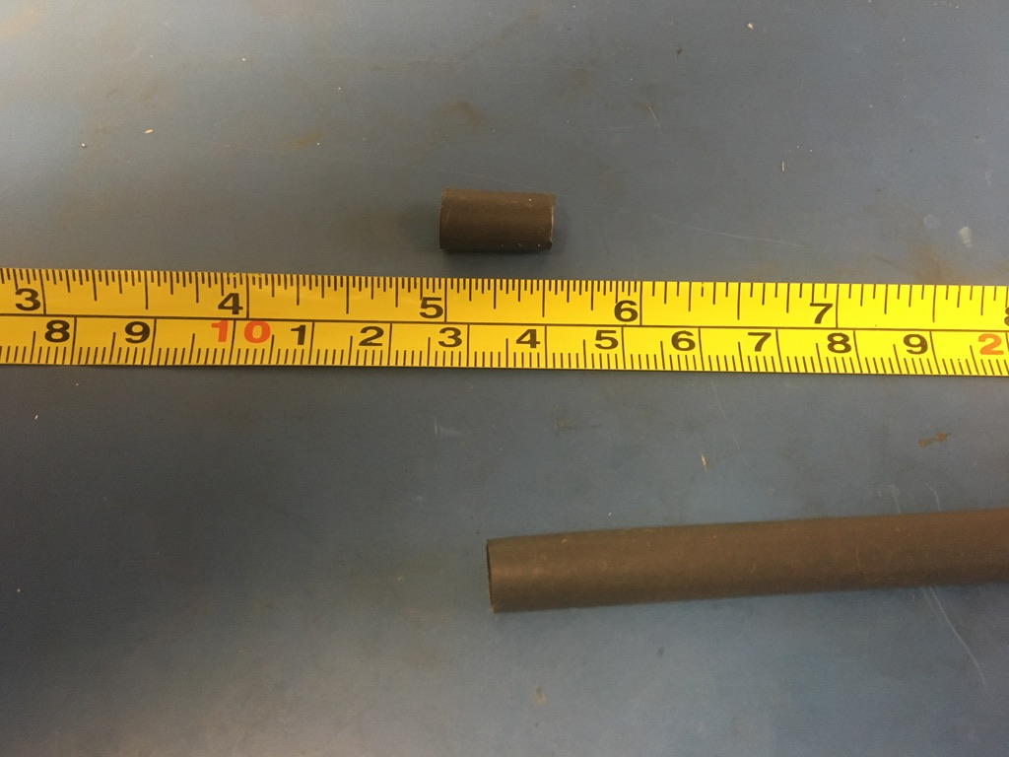
Measure out and cut one length of 6.4mm adhesive shrink tube that’s .5in long.

Slide 31
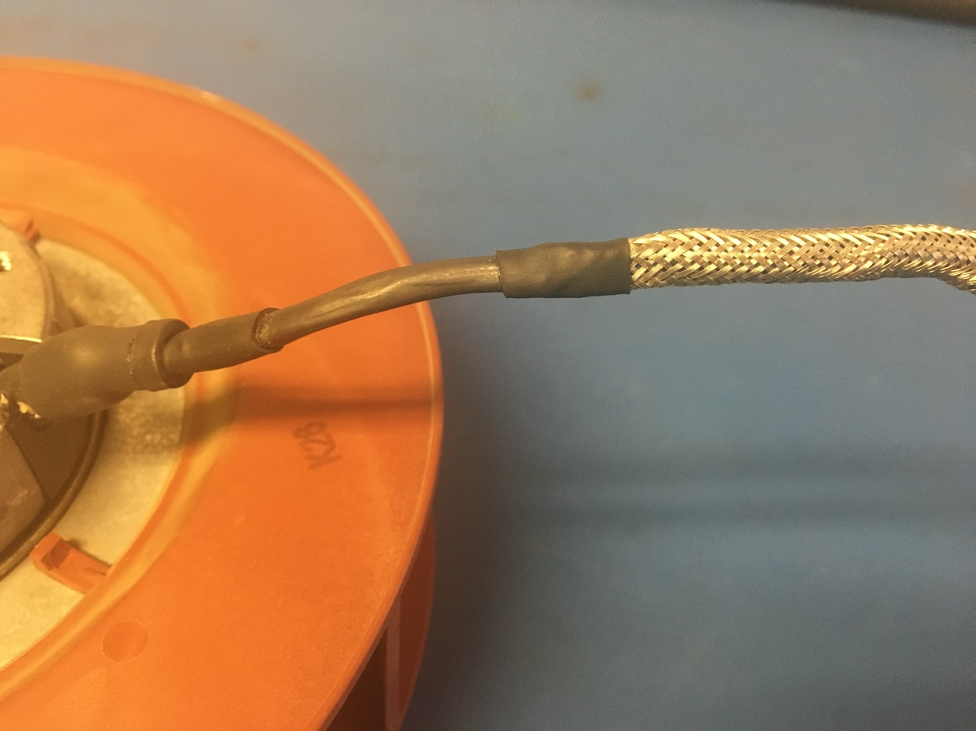
Put the piece of the shrink tube onto the metal braid end next to fan. Place the shrink tube such that the metal braid ends midway through it. Apply the heat gun.

Slide 32
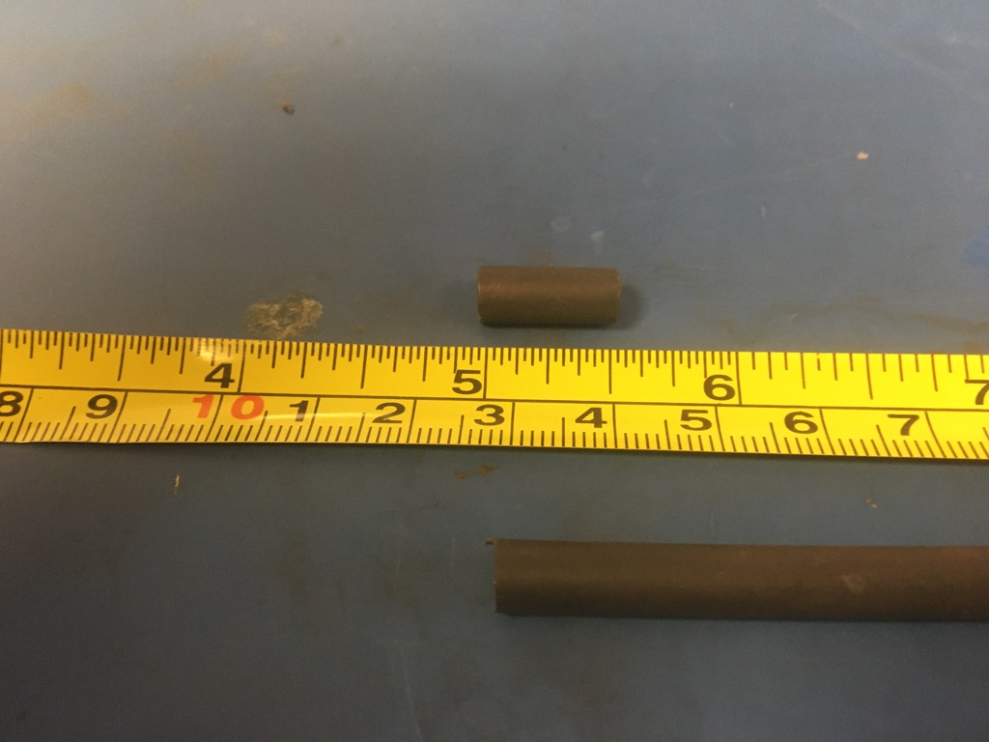
Measure out and cut one length of 4.8mm adhesive shrink tube that’s .5in long.

Slide 33
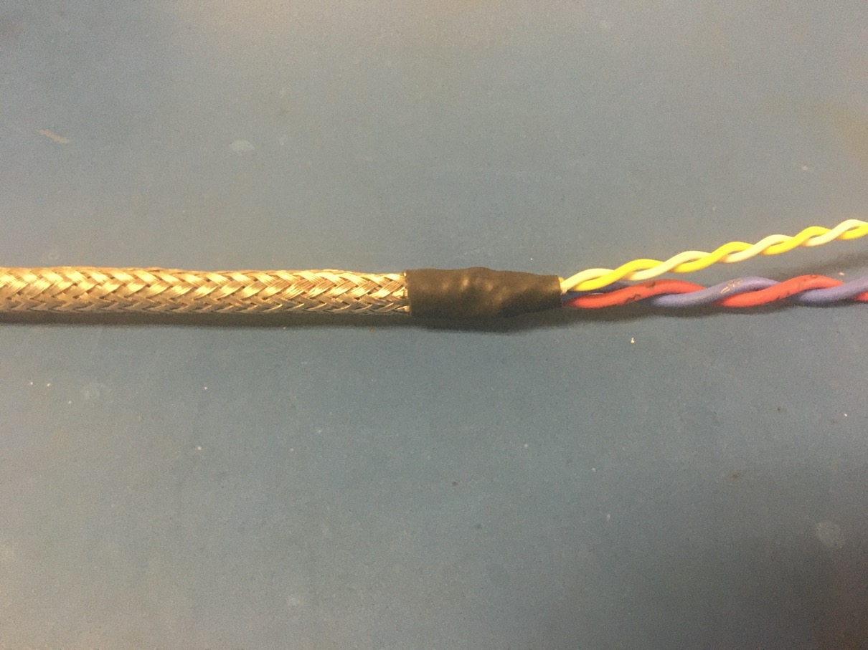
Put the piece of the shrink tube onto the other end of the metal braid (without the fan). Again, the metal braid should end through the piece of shrink tube. Apply the heat gun.

Slide 34
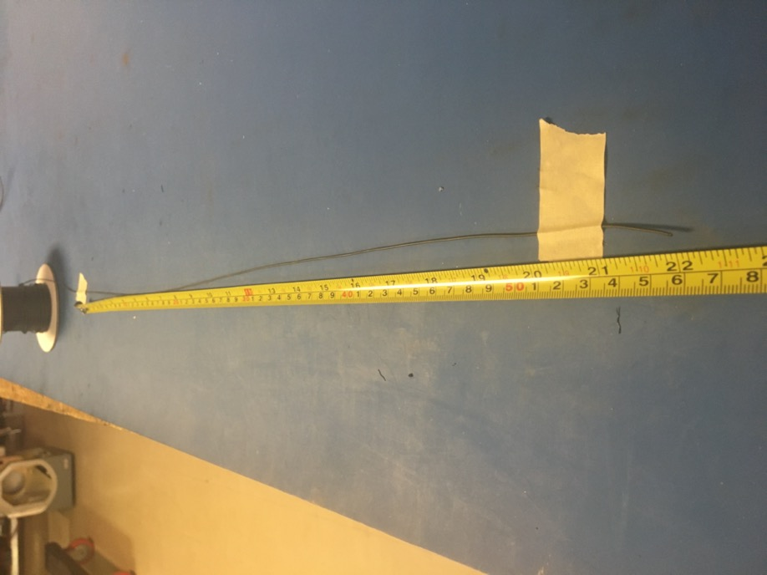
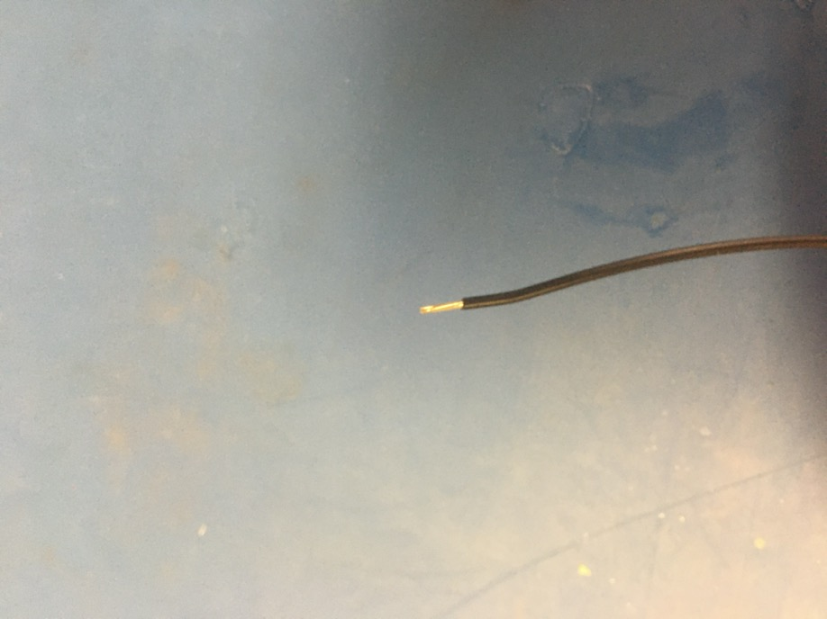
Measure out and cut 22 inches of black 24 awg wires. Strip 3-4mm off one end.

Slide 35
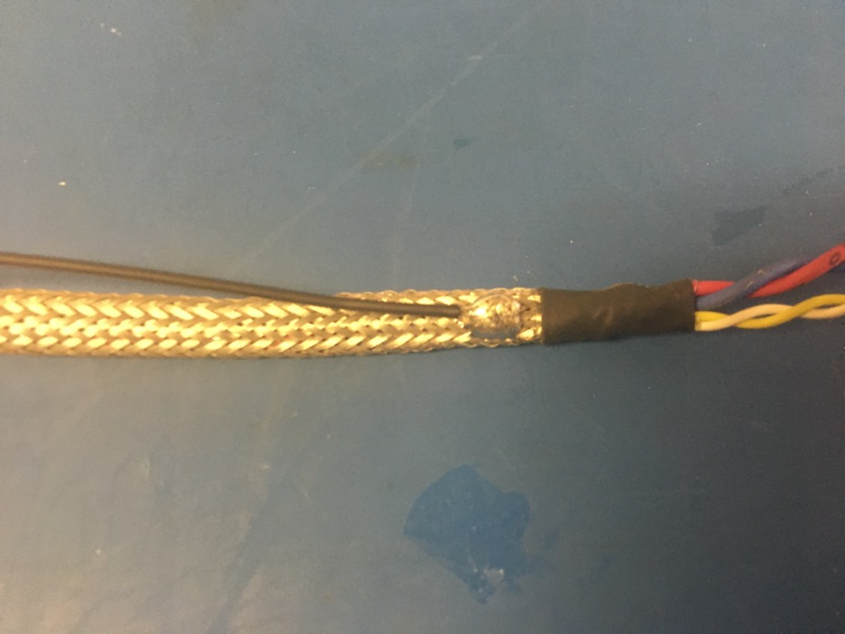
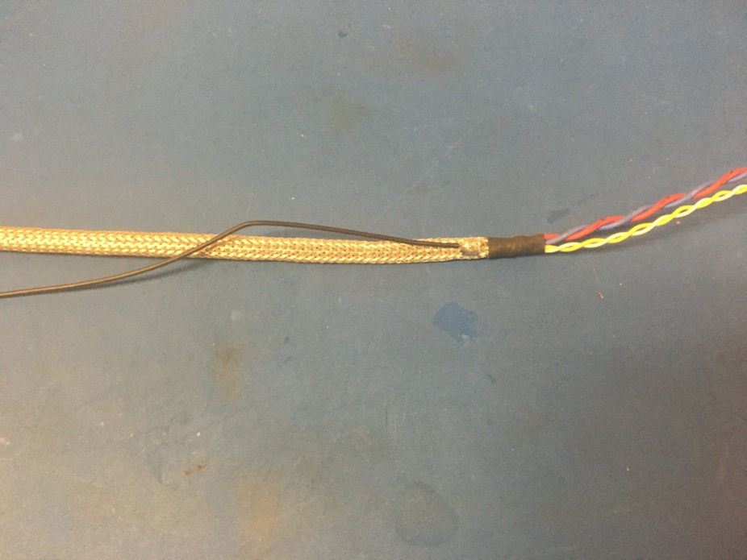
Solder the stripped end of the black wire onto the metal braid near the shrink tube joint furthest from the fan. The black wire should be soldered so the that its length runs with that of the metal braid.

Slide 36
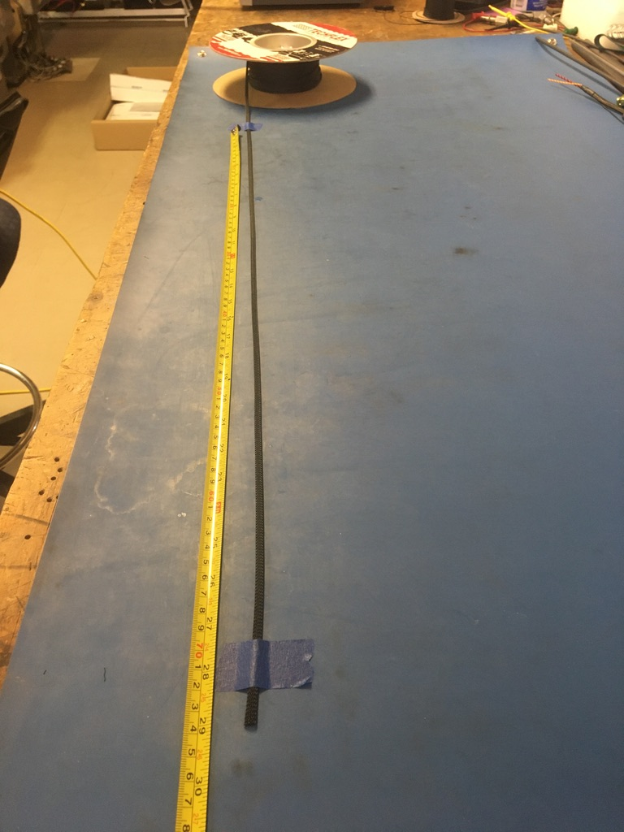
Measure out and cut 29 inches of 1/4th plastic braid.

Slide 37
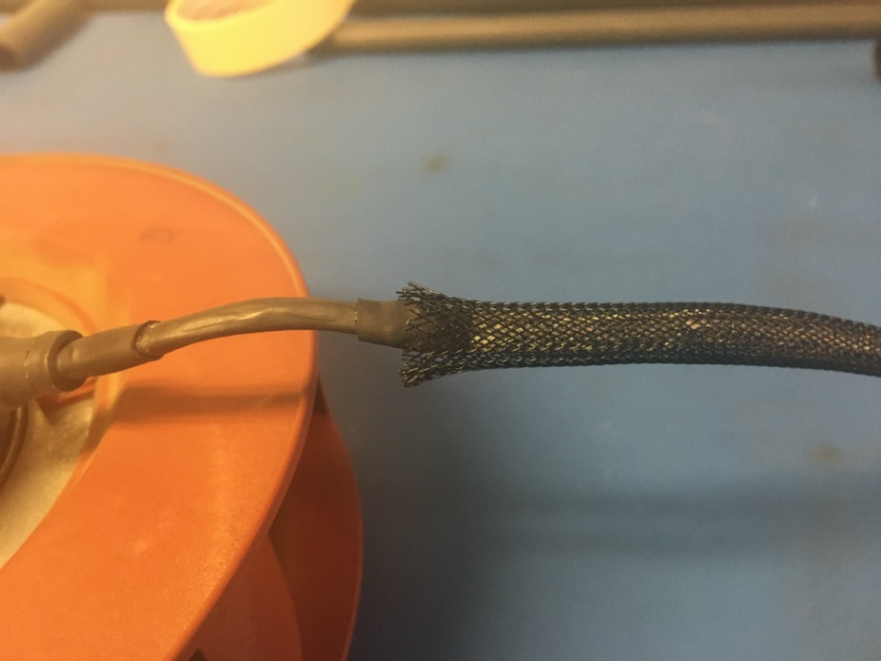

Put the plastic braid onto the wire harness. At each end of the harness, the plastic braid should end midway through the metal shrink tube joints. Thread the ground wire through one of the holes in the plastic braid so it appears as shown of the right.

Slide 38

Measure out and cut one length of 12.7mm adhesive shrink tube that is .5in long.

Slide 39

Place the piece of shrink tube onto the plastic braid end next to the fan. The plastic braid should end midway through the piece of shrink tube. Apply the heat gun.

Slide 40

Measure out and cut one length of 6.4mm adhesive shrink tube that is 1in long.

Slide 41

Place the piece of shrink tube onto the ground wire end of the harness. The shrink tube should be placed such that it covers the solder joint and the length of shrink tube beneath. Apply the heat gun.

Slide 42

Untwist about 4in of wire next to the ground wire shrink tube joint.

Slide 43


Thread the 75 magnet onto the end of the harness. Then thread the wires back through the bottom of the magnet as shown on the left. Pull the loop of wire taught so the magnet appears as shown on the right.

Slide 44


Thread the 43 magnet on just like the 75 magnet. The wires may need to untwisted more for 43 magnet.

Slide 45

Measure out and cut 1in long lengths of 4.8mm and 6.4mm adhesive shrink.

Slide 46


Place the 4.8mm piece of shrink tube onto the wire harness such that it abuts the magnets. Apply the heat gun.

Slide 47


Place the 6.4mm piece of shrink tube onto the wire harness such that it layers atop the 4.8mm piece. Apply the heat gun.

Slide 48

Measure out and cut one length of 16mm adhesive shrink tube that is 2.5in long.

Slide 49


Place the piece of 16mm shrink tube over the magnets so that about equal lengths of shrink tube are visible out of each end. Apply the heat gun.

Slide 50


Measure and cut the end of the twisted pair so that they measure 4 inches.

Slide 51


Strip all the wires (about 2-3mm). Using the KK 254 crimper, crimp on KK 254 tips. Be sure to use slot A for the yellow and white wires and slot B for the red and blue wires.

Slide 52

Once the wire ends are crimped, they should look as shown: isolation held by the first grip but not the second and a bit of exposed wire peaking out the end of the second grip.
Exposed wire just visible
Isolation in first grip

Slide 53


Before inserting the tips into the connector, have the extrusions of both face down. Then push each tip into the hole of the connector until it clicks. If there are difficulties with pushing the wire tip in by hand, use the metal extraction tool to push on the bottom edge of the it until it clicks in place. Please reference the accompanying pin out document to see where each wire should go.

Slide 54

Once all the wires are inserted, the connector should appear as shown on the left.

Slide 55

Wire harness complete! The ground wire will be given a tip later.

